Slide 1




Slide 2
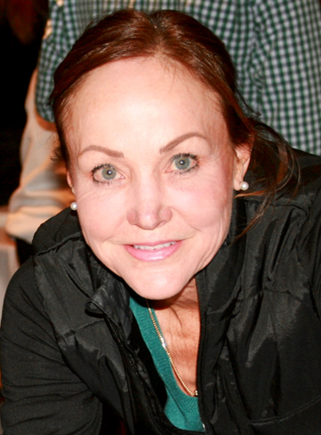
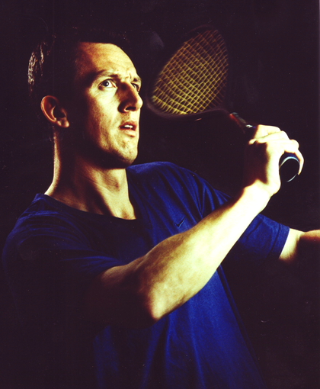
Presented by Guest Speaker
Lolly Gillen, ON
Secretary General,
Pan American Squash Federation
WSF Squash57 Commission
WSF Para-Squash Commission
WSF Inclusivity & Diversity
Working Group
2013-18 Past President of
Squash Canada
Co-founder Canadian Inclusivity
Squash Program
Pete Goodings, AB
Head Squash Professional &
Squash Manager - Royal Glenora
Level 3 Professional Coach
Squash57-2014 England Nationals 45's Finalist
4x National RAP Singles Champion (1999-2003)
England Home International Masters Team (2005)
2022 Canadian Men’s 50+ Singles Finalist
Physical Training Instructor
Applied Sports Psychology Practitioner

Slide 3
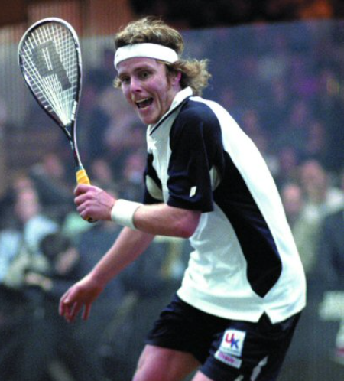
Why Squash57?
“I first want to say that I admire your relentless passion to bring additional resources to those who are limited in some way, especially to children. By bringing Squash57 to their lives, they will benefit greatly from physical exercise, which leads to friendship and overall well-being.
It makes so much sense to promote this type of game, and I hope you are successful bringing it to Canada.”
Peter Nicol M.B.E.,
Director Of Squash, Nicol Squash
Former World #1 (1998)

Slide 4
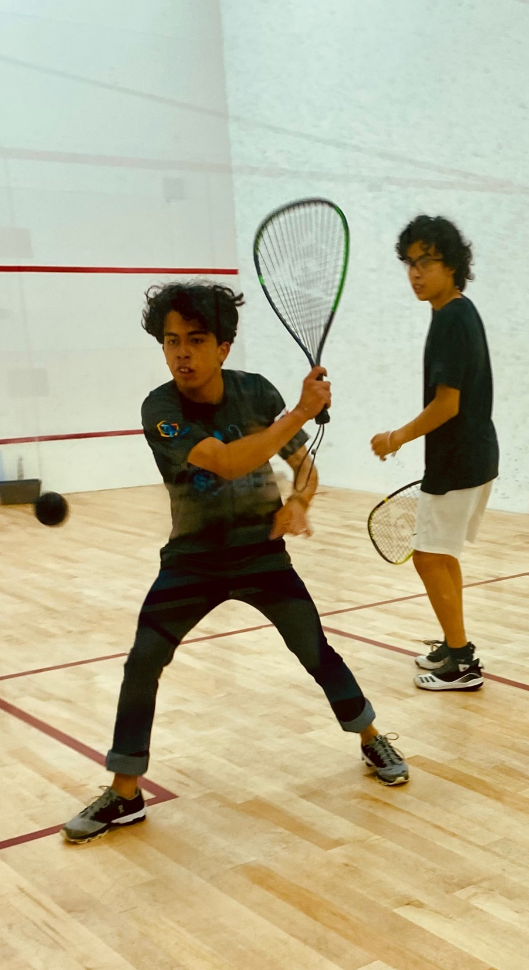
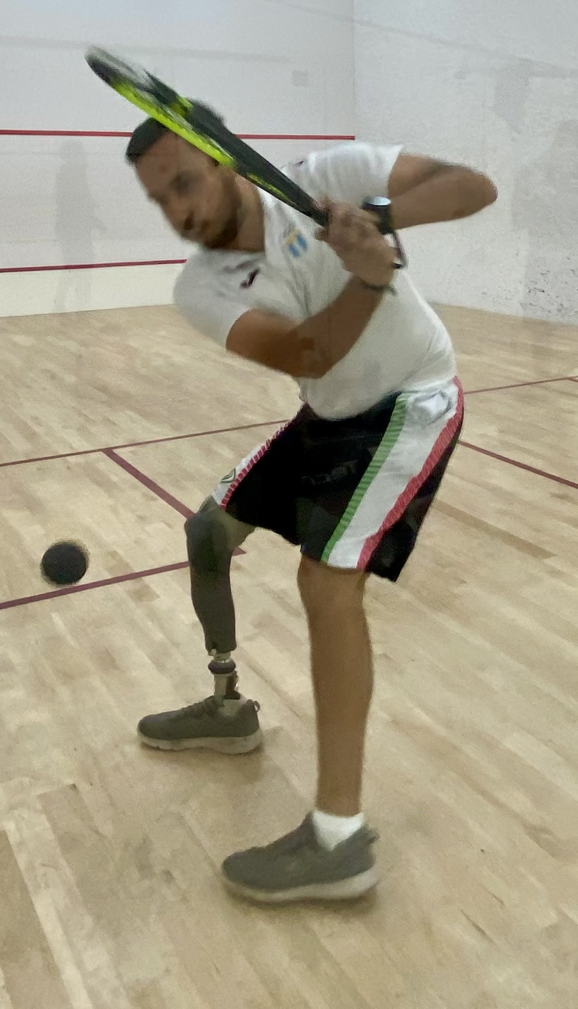
Why Squash57?
At zero expense, Squash57 offers a greater value proposition to the facility owner, to the squash professional and to the player/member :
New element of squash
Diversification in club’s program options
Doubles-play for facilities without doubles courts
Inclusivity as easier to learn for children, novices, adults and individuals with a mental, emotional or physical disability

Slide 5
History of SQUASH 57
1909- 1st squash court in Canada built
1912- 1st National Singles Championship
1974 -1st National International Singles Championship (1995 last National Hardball Championships)

Slide 6
SQUASH 57
Court
Singles & Doubles are both played on the same court
…the regulation international singles squash court.

Slide 7
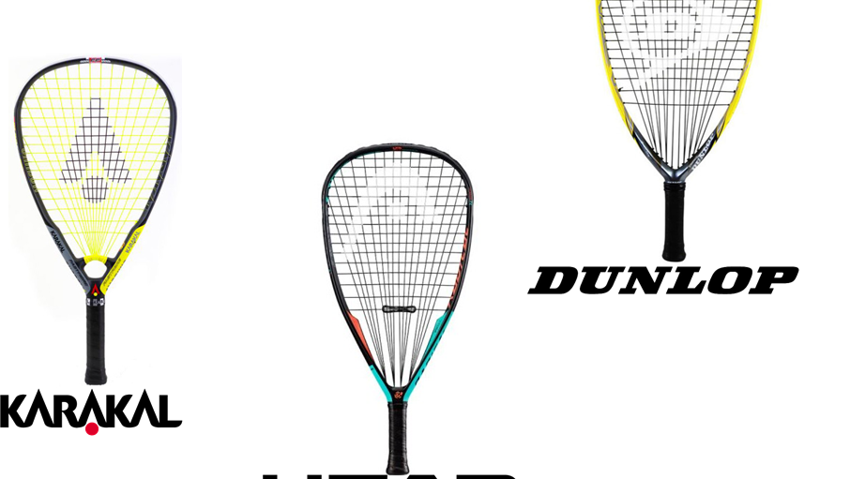
SQUASH 57’s Racquet
RACQUET LENGTH:
Maximum 22” –Squash 57
Maximum 27”- Squash

Slide 8

SQUASH 57
BALLS
Black
Blue
maximum diameter of 57mm vs
40mm for a squash ball

Slide 9
SQUASH 57’s Rules
SIMILAR TO SQUASH with 2 significant differences:
      1. THE SERVE: To serve, the ball must be bounced off the floor. Player get 2 serves. The receiver can elect to return a 1st fault-serve however if the serve is out, it is an automatic loss of serve.
  NOTE: The service line on the front wall is not in play, only the tin.
2. DOUBLES: Each player must alternate striking the ball during the rally. One team member serves an entire game, then the partner serves the entire next game; except in the deciding game (3rd or 5th) where the server on both teams must change for the balance of the game once one team has scored 5 points.
SCORING: Point a rally to 11 (Par 11)

Slide 10
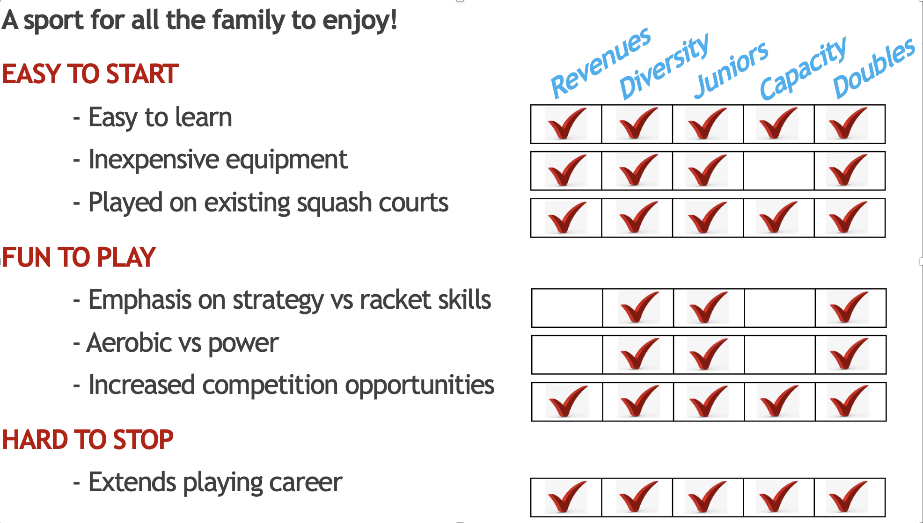
Why Squash57?

Slide 11
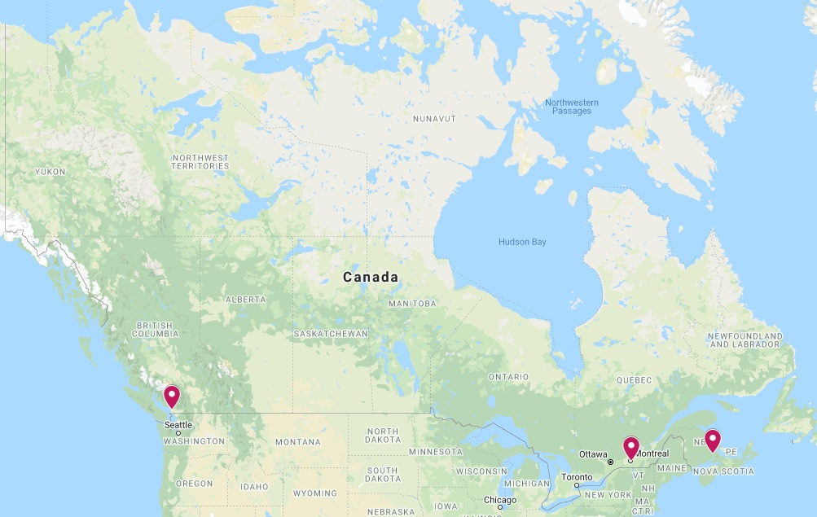
Current situation in Canada
SOFTBALL DOUBLES COURTS IN CANADA

Slide 12
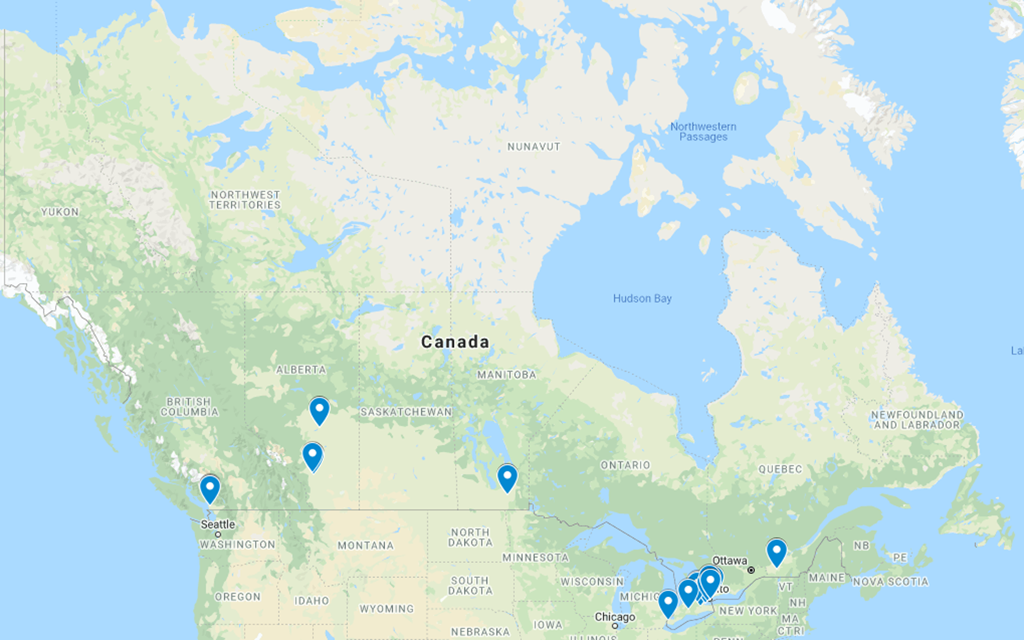
Current situation in Canada
HARDBALL DOUBLES COURTS IN CANADA

Slide 13
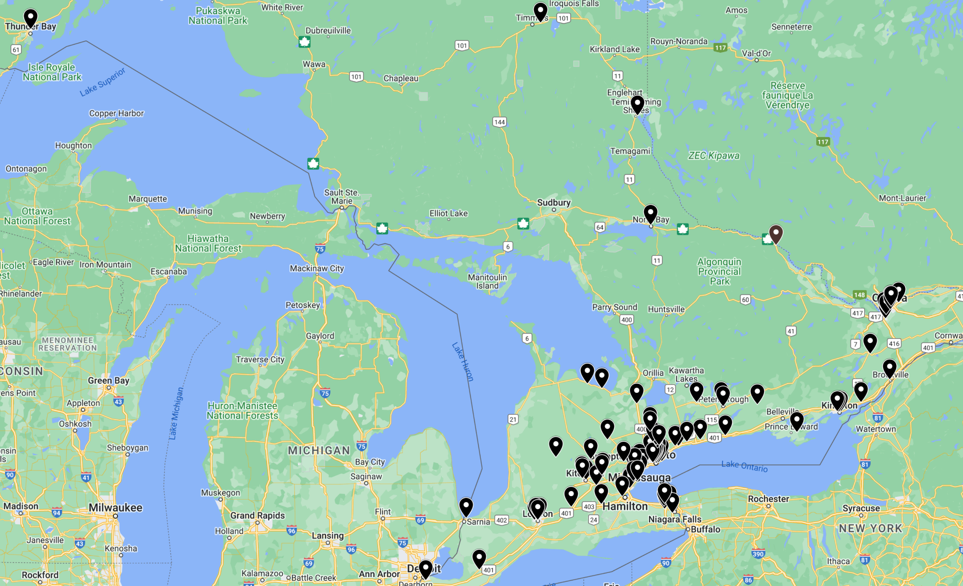
Member Facilities in Ontario

Slide 14
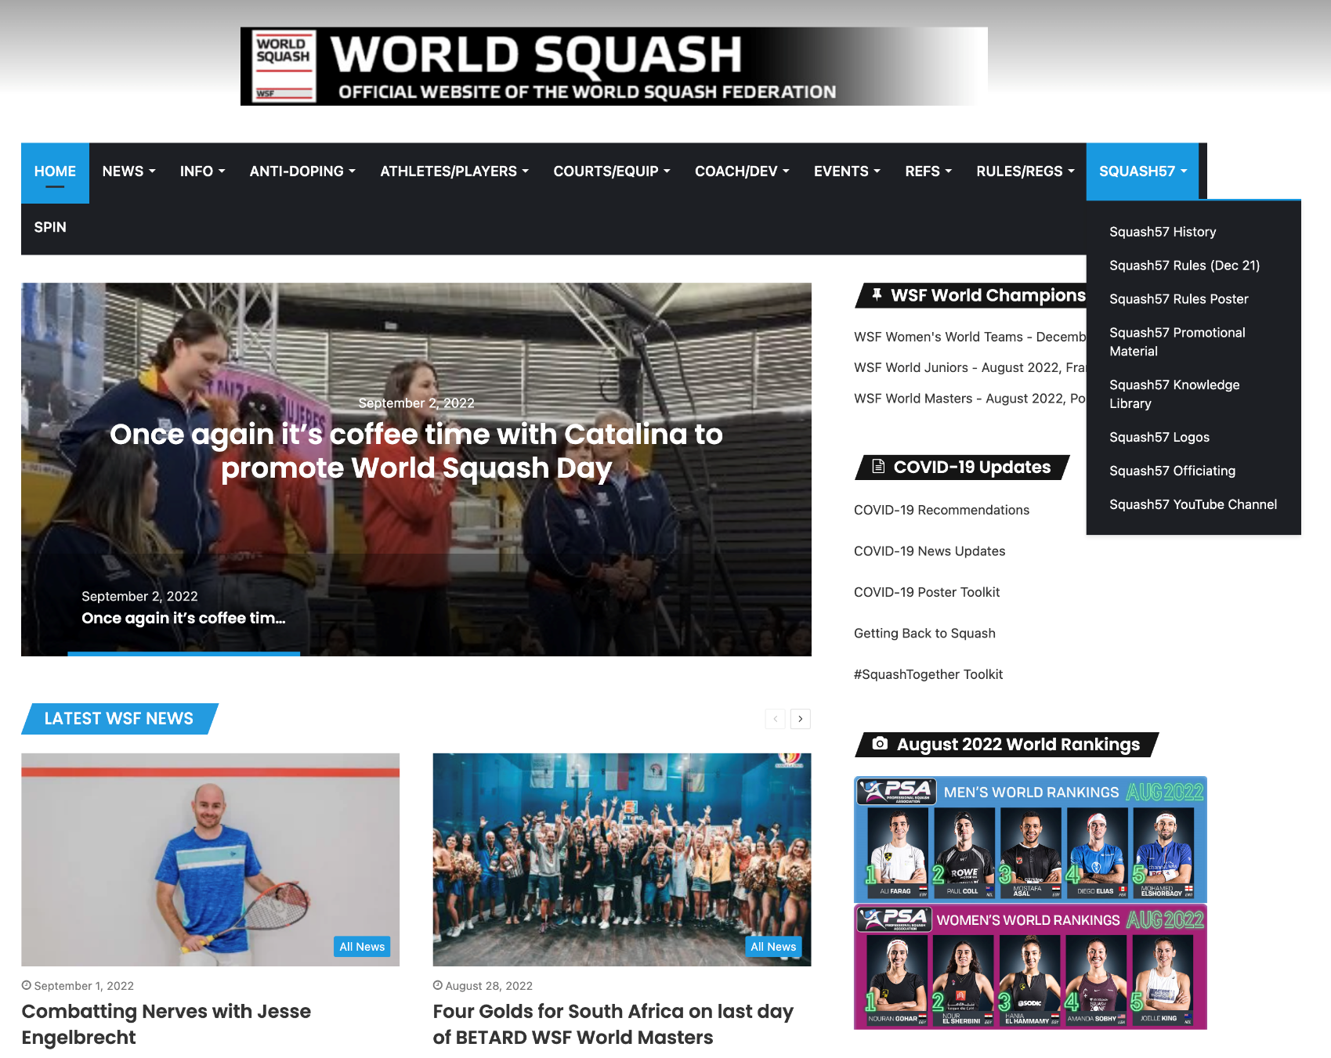
WSF SQUASH 57 Commission
CHAIR-Patrick Osborn (ENG)
Tim Baghurst (USA)
John Cordeaux (ENG)
Mark Fuller (ENG)
Lolly Gillen (CDN)
www.worldsquash.org

Slide 15

SQUASH 57 Online Resources
Intro to SQUASH57 www.youtube.com/watch?v=RA463ZYJSGo
Intro to SINGLES www.youtube.com/watch?v=yJsF7P76Y90
Intro to DOUBLES www.youtube.com/watch?v=c_iV2b6hWz8
Detailed Rules: www.worldsquash.org/squash-57/squash-57-rules/
Rules Poster: www.worldsquash.org/57-rules-poster/
England Squash: www.englandsquash.com/squash57
Squash57 Canada: www.squash57.ca
Squash57 YouTube channel : www.youtube.com/c/Squash57WSF
Squash57 Facebook page: www.facebook.com/groups/447929139060327

