Slide 1
Squash Ontario: Keeping Sport Safe
Coaches Association of Ontario - Eric McLoughlin

Slide 2
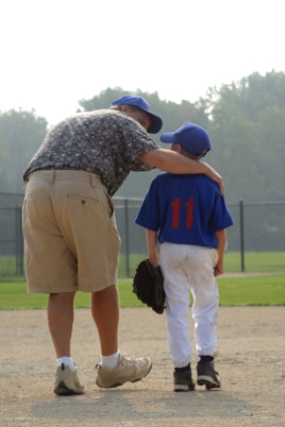
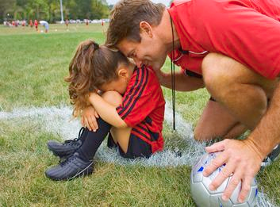
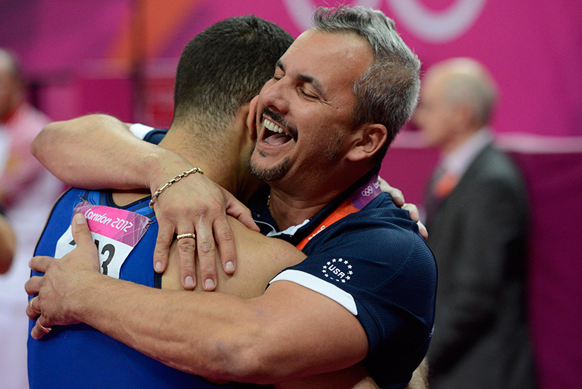
Coach-Athlete Relationship
What comes to mind when you think about the coach-athlete relationship?

Slide 3
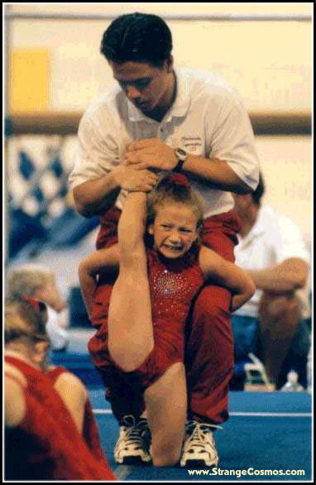
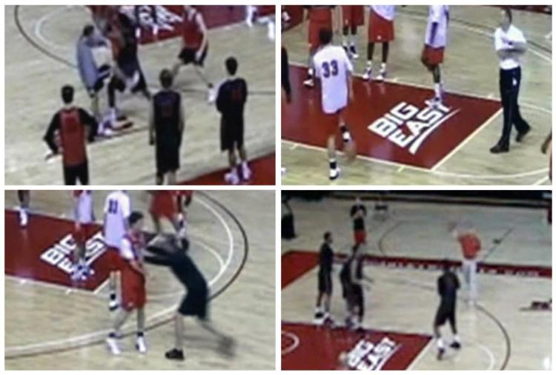
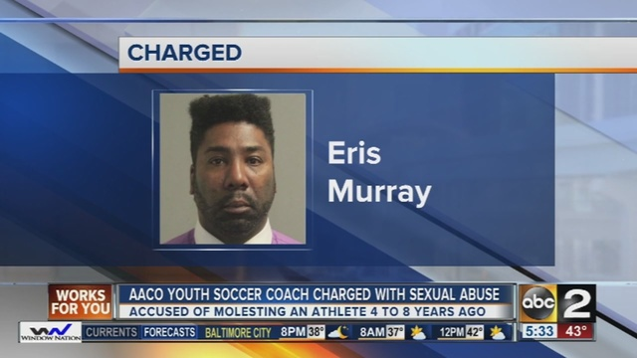
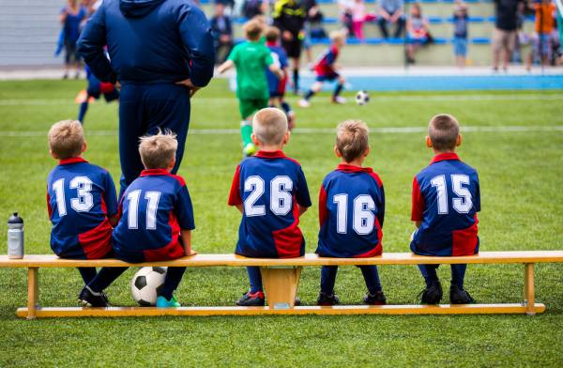
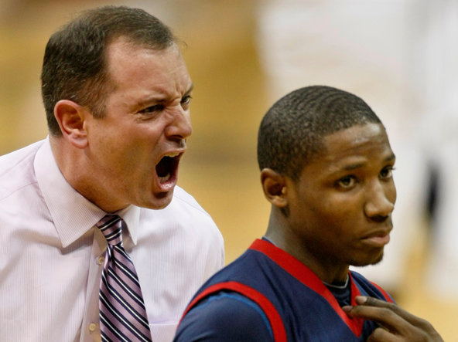
Coach-Athlete Relationship

Slide 4
Coach-Athlete Relationship
The Coach-athlete relationship is often one of the most important and influential relationships experienced by a young athlete.
Critical relationship - A caregiving relationship exists when one individual has “significant influence over [another] individual’s sense of safety, trust, and fulfillment of needs” (Crooks & Wolfe, 2007, p. 17).
Notes:
Athletes become more competitive and advance through the sporting ranks, they spend increasing amounts of time with their coaches
In addition, previous research has shown that the coach’s influence often extends beyond training into other areas of an athlete’s life including diet, academics and social interests

Slide 5
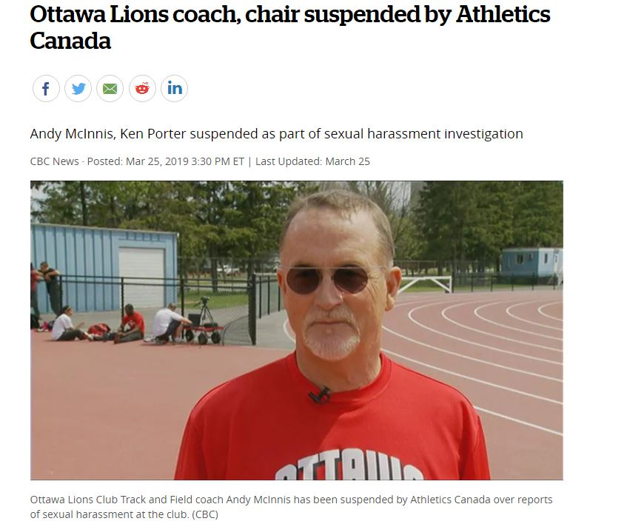
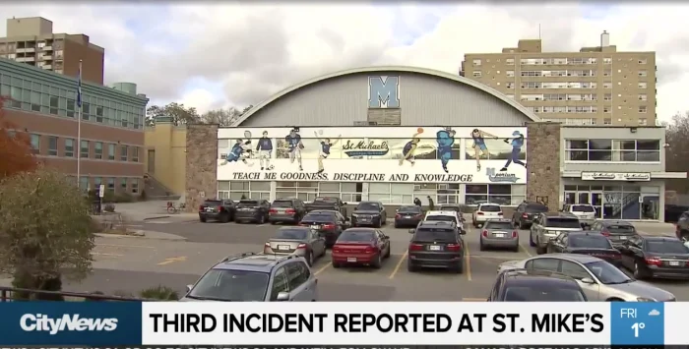
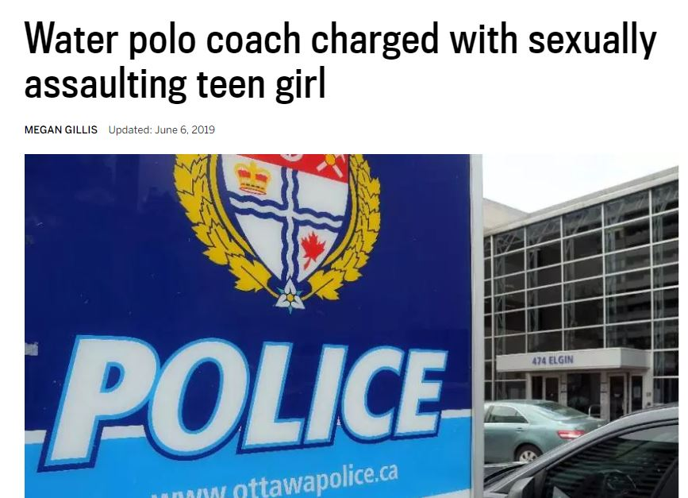
Maltreatment in Sport
An umbrella term that encompasses the different ways in which individuals may experience harm and the different types of harms that may be experienced.
Notes:
Crooks and Wolfe (2007) p. 3

Slide 6
Protecting You & Your Athletes
We all have a DUTY OF CARE to provide a safe sport environment.
TRAINING
SCREENING
POLICY
REPORTING
Notes:
Teaching and guiding towards desired/appropriate behaviour
Democratic: freedom with order and structure
Focuses on meeting basic human needs to belong, be accepted, viewed as worthy, and to be respected, keep self-esteem in-tact
Based upon teaching, guiding and encouraging toward self-control, independence and respect for oneself and others (Durrant & Ensom, 2004, p.2)

Slide 7
Training
Make Ethical Decisions (MED)
Helps identify the legal, ethical, and moral implications of difficult situations that present themselves in the world of team and individual sport.
Host your own
Attend one in-person
Virtual Classroom
Home Study
Empower+
Enhance athlete welfare by; recognizing the potential for, and presence of maltreatment in sport, learning when and how to intervene when you observe or suspect maltreatment.
Host your own
Virtual Classroom
Attend one in-person
Respect in Sport Online Training ($35)
Commit to Kids ($12)
SafeSport USA ($20)

Slide 8
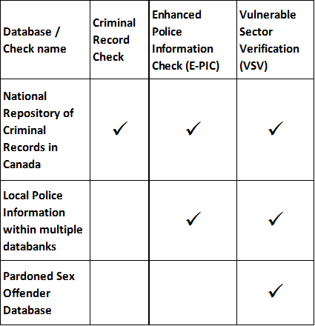
Screening
Screening involves much more than police record checks.
Screening Matrix
Criminal Records Check (CRC)
Vulnerable Sector Verification (VSV)
Enhanced Police Information Check (E-PIC)
Sterling BackCheck - $28.25

Slide 9
Policy & Procedures
Audit Checklist (See Handout)

Slide 10
Reporting
Abuse Free Sport
Canadian Sport Helpline – 1-888-83-SPORT (77678)
8am – 8pm, 7 days a week
Children’s Aid Society
Kids Help Phone
24/7 counselling, referral and information for young people (U21).
Texting CONNECT to 686868
Call 1-800-668-6868
Appoint a safety officer
How would a safety officer look in your organization?

Slide 11
Your Role in Keeping Sport Safe
Ensure you and all other coaches/volunteers/persons in authority receive proper training (NCCP).
Including continued Professional Development.
One and done is not sufficient.
Support your organization to have key policies;
Travel Policy
Code of Conduct
Rule of Two
Hazing
Ensure you and all other coaches/volunteers/persons in authority are appropriately screened.
Know where/who to report misconduct.

Slide 12
Contact Us:
Eric McLoughlin
Senior Lead, Events & Partner Development
416-426-7005
ericm@coachesontario.ca
www.coachesontario.ca/safesport

