Slide 1
SPORT ORGANIZATION MANAGEMENT FOR A POST
COVID-19 RECOVERY
Presentation by: Steven Indig

Slide 2
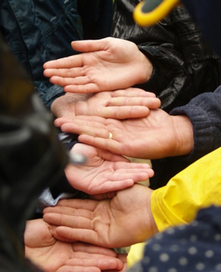
Sport Law & Strategy Group
Providing strategic insight to the Canadian sport community through professional services in these areas:
Legal Solutions and Policy Development
Risk Management
Strategic Planning and Good Governance
Communications, Facilitation and Integral CoachingTM
Event Management and Marketing
Financial Planning and Human Resource Management

Slide 3
Agenda
  Insurance
  Negligence and Risk Management
  Risk Management Techniques
    Corporate Shield
    Waivers, Assumption of Risk and Declaration of Compliance
  Litigation Matters

Slide 4
Insurance

Slide 5
Exclusions
Contagious diseases (including COVID-19, SARS, ebola, Bird Flu, Legionnaire’s Disease) are now excluded from general liability insurance policies, errors and omissions policies and travel policies
Organizations will be responsible for legal defence fees, damages (if any) and cost awards in the case of litigation
Notes:
In our experience, the Biggest fear expressed to us by any NSO, PSO or Club – having a participant seriously or catastrophically injured, then being sued for it!
On the other hand, some clients have said to me Oh I’m not worried about that – that’s what insurance is for! But reality is that Negligence is a serious allegation that can lead to serious costly consequences – not just financially but to your organizations reputation as well. - nobody wants to get sued
Good thing is, negligence is very difficult to prove – there is a 4 step legal test that must be applied to every situation in order to determine if someone can be found liable for negligence.

Slide 6
Negligence
and
Risk Management

Slide 7
NEGLIGENCE/ACCIDENTS
Negligence occurs only when:
A Duty of Care is owed,
The Standard of Care is breached,
Harm or Loss occurs, and
The breach of the Standard causes or substantially contributes to the Harm or Loss.
Notes:
In our experience, the Biggest fear expressed to us by any NSO, PSO or Club – having a participant seriously or catastrophically injured, then being sued for it!
On the other hand, some clients have said to me Oh I’m not worried about that – that’s what insurance is for! But reality is that Negligence is a serious allegation that can lead to serious costly consequences – not just financially but to your organizations reputation as well. - nobody wants to get sued
Good thing is, negligence is very difficult to prove – there is a 4 step legal test that must be applied to every situation in order to determine if someone can be found liable for negligence.

Slide 8
DUTY OF CARE
To whom do you owe a duty of care?
“To anyone who you ought to know could be affected by your actions”
Coaches→ Athletes
Club → Participants/Coaches
Notes:
Going to cover each element of the 4 step test briefly so that you can get a better understanding of what is required in order to meet the test:
Everybody owes a duty of care to someone or another at some point in their lives – as Parents to our children, as employers to our employees, etc.
The Law says you owe a duty of care to anyone who you ought to know could be affected by your actions.
So for you guys – coaches owe a duty of care to their athletes – to provide them with a safe environment
Clubs Administrators - owe a duty of care to act in the best interests of your organization, and to ensure that your participants are provided with a safe environment

Slide 9
STANDARD OF CARE
Written/published standards
  Equipment standards
  Organization policies & rules
  Government Regulations
  Return to Sport Protocols
  AAS Risk Management Tool (OTP Risk Assessment/Mitigation Tool)
Unwritten/unpublished standards
  New developments and Trends
  Networking
Case law
Common sense
  Intuition
  Knowledge
  Experience
  Gut
Notes:
The standard of care to which you will be held is determined by many different factors and may vary depending on the age and skill level of your participants.
Often the expected standard of care will be outlined within your organizations by-laws or policies such as code of conduct – as well as any coaching or leadership manuals you may be presented with when you are brought into the organization.
But there are also unwritten standards or norms within the sport community that you will need to be mindful of. This is where is important to network with other curling clubs or provinces – find out what they are doing to ensure they meet their duty of care.
Club excellence out here? Like a housekeeping stamp of approval offered to clubs that can show they are ahead of the curve, have adopted risk management into their day to day decision making, etc. If your club is not keeping up to date or informed, you could be falling below the unwritten standard.
Two main Canadian cases that are consistently referred to in any Negligence cases involving sport and I will go over those briefly in a little bit because they lay out what the expected standard of care is for sport providers
But often times you have to rely on your common sense – saying to yourself, I have young kids on the ice, what can I do to ensure that they are protected?
Really important to ensure that you are always up to date with the written and unwritten standards (relevant to curling) so that you can be aware of the standard of care expected by your members or participants is met.

Slide 10
STANDARD OF CARE
Highest possible level of care
- risk is eliminated
Reasonable standard of care in the circumstances - risk is appropriately
managed
Failure to exercise any care
- risk is ignored
Behaviour is not negligent
Behaviour is negligent

Slide 11
Risk Management

Slide 12
Definitions …
RISK →
The chance of something happening that can have an impact on achieving desired outcomes
RISK MANAGEMENT →
The process used to identify, assess and treat risks so as to better achieve desired outcomes

Slide 13
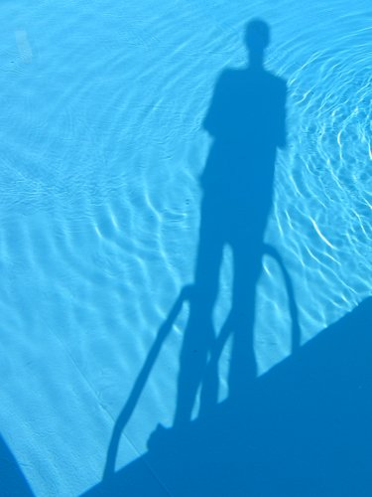
RISK MANAGEMENT 101
Identify risks – ask, what are the things that can go wrong?
Measure and evaluate risks – ask, what is the chance it will go wrong, what are the consequences if it does?
Control risks – ask, what can I do about it?
Notes:
Risk management is the process by which you choose to identify, measure, evaluate and control risks that may be facing your organization or programs
Question should not be limited to What are the risks if we do this, but also consider what are the risks if we don’t do this?

Slide 14
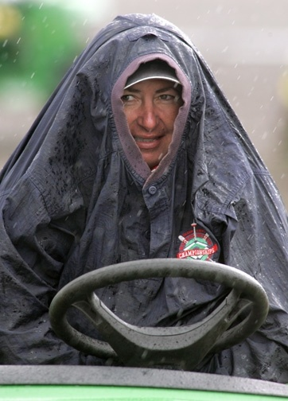
Identify Risks
COVID Related Risks:
Compliance Risks
Financial Risks
Communications Risks
Operational/Program Risks
Reputation Risks

Slide 15
EVALUATE RISK
  Low: will have an impact on achievement but can be dealt with through internal adjustments
  Medium: will have an impact on some aspect of achievement but that will require changes to strategy or program delivery
  High: will significantly impact the achievement and the organization
  Catastrophic: will have a debilitating impact on the achievement and the organization

Slide 16
CONTROLLING THE RISK
Retain the risks → you don’t do anything because the risk is inherent in the sport
Reduce the risks → you take steps to reduce the likelihood of occurrence, and/or the consequences, largely by changing human behavior
Transfer the risks → you accept the level of risk but you transfer this risk to others through contracts (insurance, waivers, other business contracts)
Avoid the risks → you decide simply to NOT do something
Notes:
Once you have identified, measured and evaluated the risks – you only have 4 options available to you when it comes to deciding how to control the risks.
You can retain it, reduce it, transfer it or avoid it

Slide 17
REALITY CHECK
The law does not cut you slack because you are ‘volunteer-based’ or ‘volunteer-led’.
But Remember…
The law never expects perfection, it only expects reasonableness
Notes:
That duty of care exists even if you are volunteer-based or volunteer led, however, if you can show that you had a Risk Management Plan in place and you took all the steps necessary to mitigate those risks, then that would go a long way to showing that you were acting in an “reasonable” way.

Slide 18
Risk Management Techniques

Slide 19
Return to Sport
Adherence to Provincial/Territorial government regulations and guidelines
All organizations and businesses should develop and implement policies and procedures to mitigate the transmission of COVID-19 prior to re-opening sport and their offices

Slide 20
Return to Sport
Precautionary Measures may include
  Constant Communication and Education
  System for regular cleaning, sanitization and inspection
  Keep a record of steps taken
  Post clear signs
  Declarations/Attestations
  Waivers/Assumption of Risk Documents
  (Keep records)
Notes:
The Supreme Court recently upheld a BC Court of Appeal decision to reject a law suit against an organization that offers zip lining by two individuals who were injured as a result of the admitted negligence of the organization. Even with the evidence of negligence, the court deemed that because the participants had signed the waivers, they were precluded from filing a law suit.
The court found that it is standard business practice for sport organizations to request that waivers be signed, the participants were made aware of the obligation to sign one if they wanted to participate, they were made aware of the associated risks in advance and were given adequate time in which to read the waiver before signing it.
The appellants were trying to argue that a waiver is appropriate in instances were the participant has control over their own actions, but that in cases when the participant does not have control – ie the organization staff hook them up, check their belts, etc to ensure secure, - that waivers should not be enforceable. Court disagreed.

Slide 21
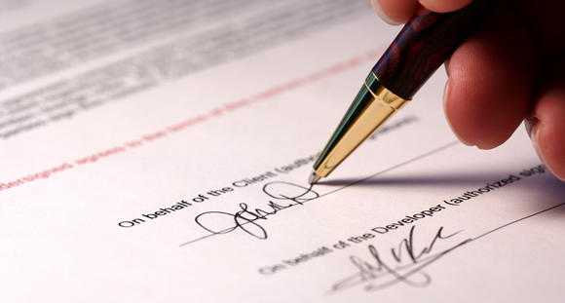
WAIVERS
An intentional, informed and voluntary agreement to give up a known legal right
Notes:
And this brings us to my final topic of the day – which is Waivers. Every sport uses them as a way to mitigate risks – as a way to transfer the physical and legal risks associated with participation in a sport activity to the participant themselves. By having them sing a waiver, you are basically asking them to agree to give up their right to sue you should something go wrong.

Slide 22
2 TYPES OF RISK IN SPORT
PHYSICAL RISK
The risks, dangers and hazards that are inherent in the sport activity. These risks are unavoidable, reasonable and in many cases, desirable
LEGAL RISK
The risk that the organizers of the sport activity will behave negligently. This risk is not inherent in the sport, nor is it desirable, reasonable or acceptable

Slide 23
CONSENTING TO RISKS
PHYSICAL RISK
A participant can consent to physical risks by the act of participating or by verbal or written agreement.
LEGAL RISK
A participant can consent to legal risks ONLY by means of a written agreement. This is a “waiver of liability” agreement

Slide 24
Waivers
CONTEXT – is the waiver being used in a setting that is appropriate for such use
WORDING - is the waiver easy to read and understand?
CONTENT - are all activities, all parties, all risks covered (including negligence)?
EXECUTION - does person have authority to sign a contract, did they have an opportunity to read and understand the contract, did they sign the contract voluntarily?
Notes:
In order to ensure that a waiver is enforceable, you need to make it easy for the participant to read and understand, you need to include all the activities and associated risks they may be facing so they can make an informed decision, and you have to ensure that the person has the authority to sign it, and signed it voluntarily.
Ensure that all of these are done, you can be almost guaranteed that it will be enforced by the courts.
Lets go back to authority – can minors sign a waiver? No, can their parents sign one on their behalf? No – not a waiver, because a waiver includes waiving the right to sue for negligence. If you have minor involved in your sport, you have to use a slightly different form, (usually called an Assumption of Risk Form, or Participant’s Agreement) which still lays out all the risks, gets the parent to acknowledge the risks inherent in the sport and give permission for child to participate in any event, and will assume responsibility for any injury that occurs – the difference is that you cannot ask them to waive the right to sue you if you or your organization’s negligence caused their child’s injury. In the eyes of the law, an adult can only decide to waive that right for themselves.

Slide 25
Corporate Veil

Slide 26
Incorporation and the Corporate Veil
Limited liability
The law recognizes people and corporations (societies)
Corporations can sign contracts, purchase property, be sued and assume liability
Individual members are legally protected from having to pay any of the liabilities or debts that the organization may incur. There are some limits to the extent of this protection and many organizations purchase both organizational liability and director's liability insurance.

Slide 27
Litigation Matters

Slide 28
Incorporation and the Corporate Veil
Personal injury lawyers usually work on contingency fee (they retain a portion of the award to be compensated for their fees)
Without insurance, there is likely no money to be collected, therefore the lawyer would likely charge an hourly rate to the claimant making the process expensive
It will be difficult to prove causation – how did the person contact COVID-19?
Damages may be minimal

Slide 29
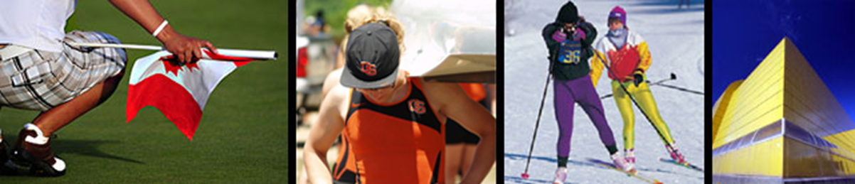
For more information, visit:
Steven Indig
647-348-3080
sji@sportlaw.ca
www.sportlaw.ca

