Slide 1
Building Capacity to Increase Retention Rates for Girls and Women in Sport
Squash Ontario – Gender Equity Presentation
June 14, 2019

Slide 2
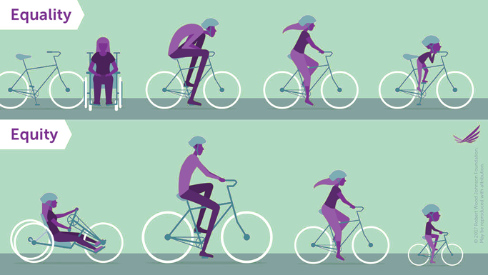
Gender Equality vs. Gender Equity

Slide 3

Movement on Gender Equity
Federal government made a commitment to achieving gender equity in sport at every level by 2035. Includes a three-year commitment of $30 million to support data, research and innovative practices to promote girls' and women's participation in sport. (2018)
Ontario government developed Advancing Opportunities for Women and Girls in Sport: Ontario’s Action Plan in which PSOs are required to have policies in place to ensure equal access and fair opportunities for women and girls. (2017)
Safe Sport/Responsible Coaches Movement

Slide 4
Squash Ontario and CAAWS Working Together
Building Capacity to Increase Retention Rates for Girls and Women in Sport Project
2-year project- April 1, 2018 to March 31, 2020
Funded by Ontario Sport and Recreation Communities Fund (OSRCF)
10 PSOs involved: Volleyball Ontario, Ontario Basketball, Rugby Ontario, Freestyle Ontario, Ontario Weightlifting, Muaythai Ontario, Judo Ontario, Canoe/Kayak Ontario, Softball Ontario, and Squash Ontario.

Slide 5
How Can Gender Equity Meet Organizational Priorities?

Slide 6
PSO Athlete Data Comparison
Nationally: 41% of girls aged 3 to 17 and 84% of women do not participate in sport

Slide 7
PSO Coach, Official, Board Data Comparison
Nationally: 29% of board members are women; 35% of certified coaches are women; 30% of officials are women

Slide 8
Why Focus on Gender Equity?
Revenue – more female members = more $
Untapped market- with so few women engaged as players, coaches, officials, etc. the opportunity for growth is very high- female engagement is an untapped market
Good customers – they book lessons, attend clinics, bring friends and bring their children
Wider talent pool - Skilled women provide the organization with an important talent pool of administrators, coaches and officials.
Investment potential - changing the image of women in sport attracts public interest and private investment. In turn, more members are attracted to the organization.
Prestige and forward thinking - taking the lead in promoting girls and women brings prestige and support to the organization.
Responsibility - by fulfilling their legal responsibility to treat fairly everyone involved in the organization and making a commitment to gender equity, organizations avoid a negative public image as well as the time and expense of dealing with unnecessary lawsuits.

Slide 9
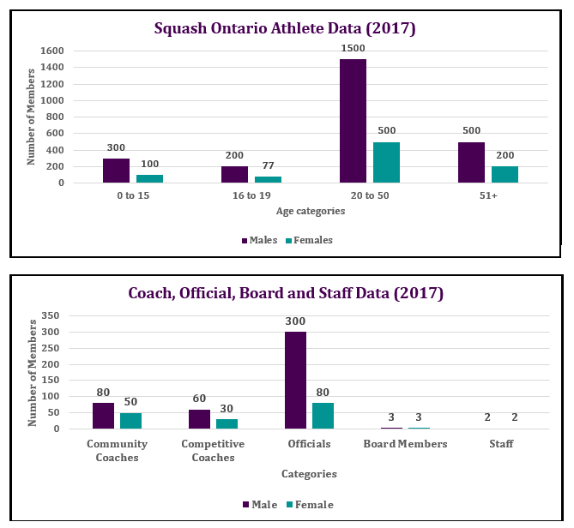
Squash Specific Gender Equity Gaps

Slide 10
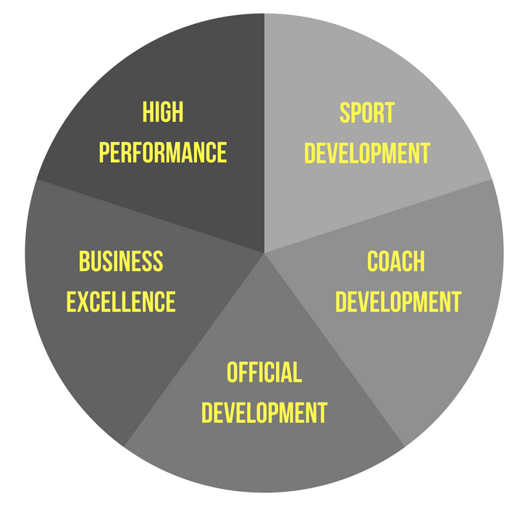
Squash Specific Gender Equity Next Steps

Slide 11
Squash Specific Gender Equity Next Steps
Sport Development
Create resources for marketing and programming for women and girls
Coach Development
Coach Certification courses targeting females / subsidies
Business Excellence
Official Certification/ Rules Clinics targeting females
Create GE Policy / Accountability
Launch GE Committee
Certification progression incentives
Certification progression incentives
Learn to Play initiatives for women/girls
Learn to Train and Train to Compete opportunities for women/girls
Club Excellence Programs/Mentorship
Secondary school and university league development
*First Step*
Official Development
High performance

Slide 12
Promising Practices for Engaging Girls and Women
Female only - offer girls and women’s only where possible and try to have female coaches and officials
Mix groups and abilities - if you are working with a mixed group of juniors or adults, switch up the groups so that participants get experience practicing with different people, and get a chance to have a female-only group even if they are at different skill levels
Create women's only divisions in club competitions - even if you only have 3 women and 35 men, do your best to allow the females to compete against each other and be recognized as such, even if they are mixed into the general competition. This will help build/encourage women to compete.
Coaching - plan to use positive reinforcement and be receptive to feedback when coaching women and girls
Marketing and Communications - flyers aren't enough, focus on word of mouth, create social meet-up groups and tap into social media groups (i.e. mom’s groups, retired teachers)

Slide 13
Promising Practices for Engaging Girls and Women
Fun and social - offer just for fun events in addition to competitive and develop socials around them (after match coffee clubs, potlucks, etc.)
Skill Building - offer try-it or learn to play days to build skills and confidence for women at all levels
Hire, train and showcase female leaders – hire and train more female leaders within your clubs and plan to showcase their involvement/achievements (athletes, coaches, officials, board members, etc.) in newsletters, social media, awards, etc.
Engage parents – get them on-side to be supportive to retain girls and be more involved as members, volunteers, coaches, etc.
Involve Families - develop events and activities that involve the entire family
Create partnerships – to increase membership and as a great way to get a group of people in the door. This could be another sport group, a nearby office, etc.

